Slide 1
Basics of Writing
Notes:
Intro with background
- Capts and Majors not know how to write and route paperwork
Don’t be that Lt

Slide 2
Overview
Background
Writing/Drafting
Editing /Reviewing
Types/Examples

Slide 3
Background
Writing is useful for record keeping & mass communication
The way you write is a reflection of your professionalism
Bosses you never meet may judge you based on your writing
AFH 33-337, The Tongue and Quill
Provides guidance on Air Force writing and briefing
Notes:
-story of a ADEWS emails making to the state department
There are many instruction that cover writing
-plain writing act of 2010
-

Slide 4
Writing/Drafting
Write with FOCUS
Focused: Address the issue and nothing else
Organized: Systematically present information
Clear: Communicate clearly and make each word count
Understanding: Know your audience and expectations
Supported: Use logic and support to make your point
Notes:
FOCUS Principles
•Focused: Address the issue, the whole issue, and nothing but the issue. •Organized: Systematically present your information and ideas.
• Clear: Communicate with clarity and make each word count.
• Understanding: Understand your audience and its expectations.
• Supported: Use logic and support to make your point.

Slide 5
Writing/Drafting
What's the purpose?
Direct, Inform, Persuade, and/or Inspire
Be detailed and avoid generalizing
Write using plain language
Resumes, 8th grade vocabulary
Minimize the jargon
Active vs Passive voice
Active voice can get to the point quicker
Notes:
Be detailed, item should have enough information to stand alone
Passive: Water is drunk by everybody. Active: Everybody drinks water

Slide 6
Editing/Reviewing
Best done with fresh eyes
Review the basics of writing
Pronoun-antecedent agreement, plural vs singular (p.99)
Subject verb agreement (p.98)
Misplaced modifiers (p.97)
Common errors on page (p.101)
Ch 25 – Ch 28
Notes:
-fresh eyes, wait few hours or a day if needed
- Slow down, Read aloud or cover
- Big picture, Organization and cohesion, have a clear purpose

Slide 7
Editing/Reviewing
Slow down and take your time
Remember your readers
Start with the Big Picture
3 reviews
Big picture, paragraph structure and clarity, the small detail
Know the local standard
AU-1
Notes:
-fresh eyes, wait few hours or a day if needed
- Slow down, Read aloud or cover
- Big picture, Organization and cohesion, have a clear purpose

Slide 8
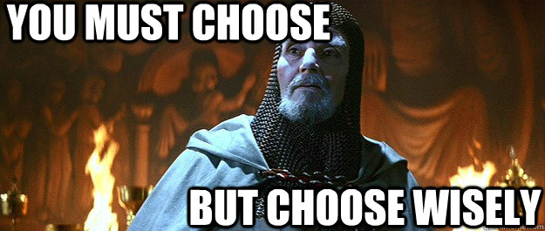
Document Types

Slide 9
Types - Memorandum
Uses: The official memorandum informs personnel and documents actions where Airmen need to make an official, written record of an event, decision, or action.
Common Types
MFR
In Turn
Indorsement

Slide 10
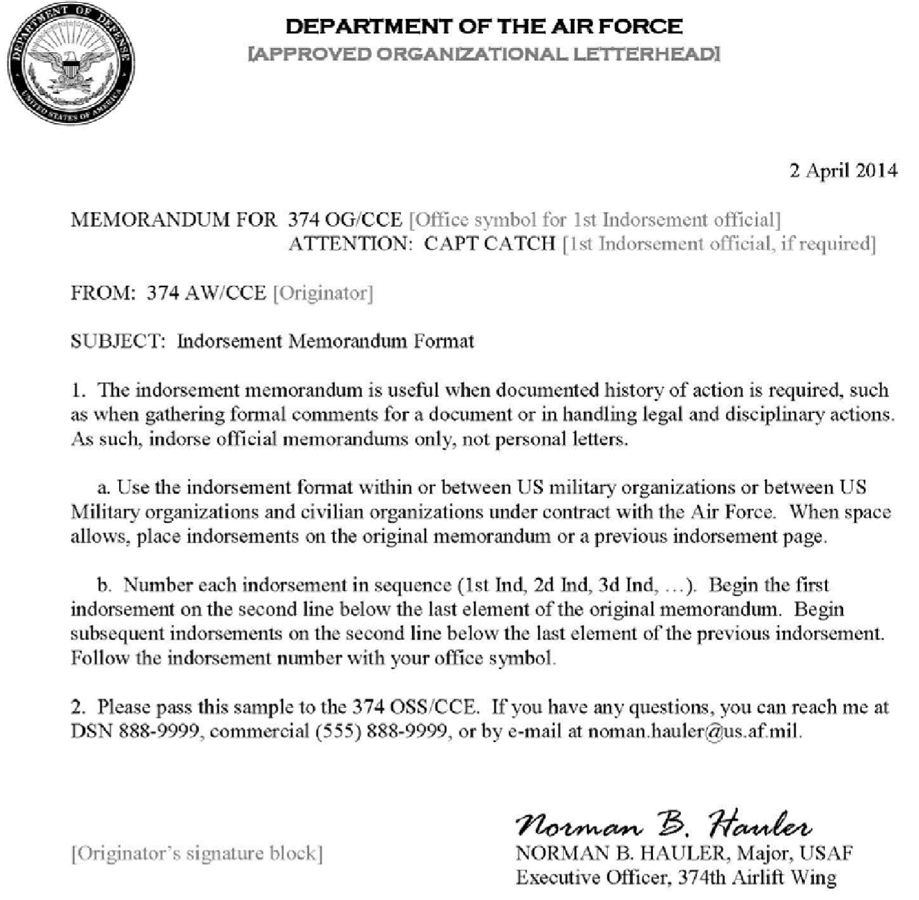
Types - Memorandum
Letterheads
Can affect the FOR line
Always have a contact line
Can be different than the signer
No Hyperlinks
Sign on same page

Slide 11
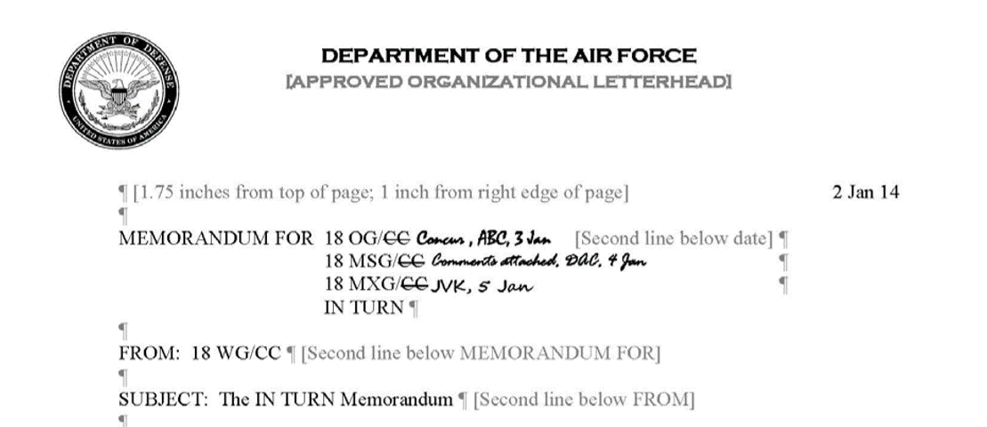
Memorandum
In Turn: When the memorandum needs a record of review without the formality of the indorsement format

Slide 12
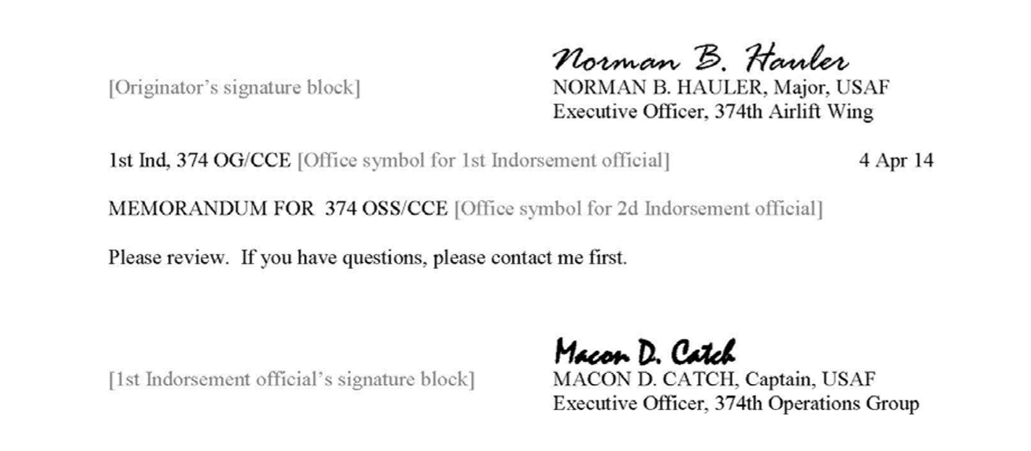
Memorandum
Indorsement: When the memorandum must be signed to acknowledge receipt or action.
- The letter of reprimand (LOR)

Slide 13
Types - Personal letter
Uses: your communication needs a personal touch or when sincerity is essential
Use it to write a private matter for praise, condolence, sponsorship, etc.
Promotions and Letter Of Appreciations
Keep it brief, preferably no longer than one page
Avoid using acronyms

Slide 14
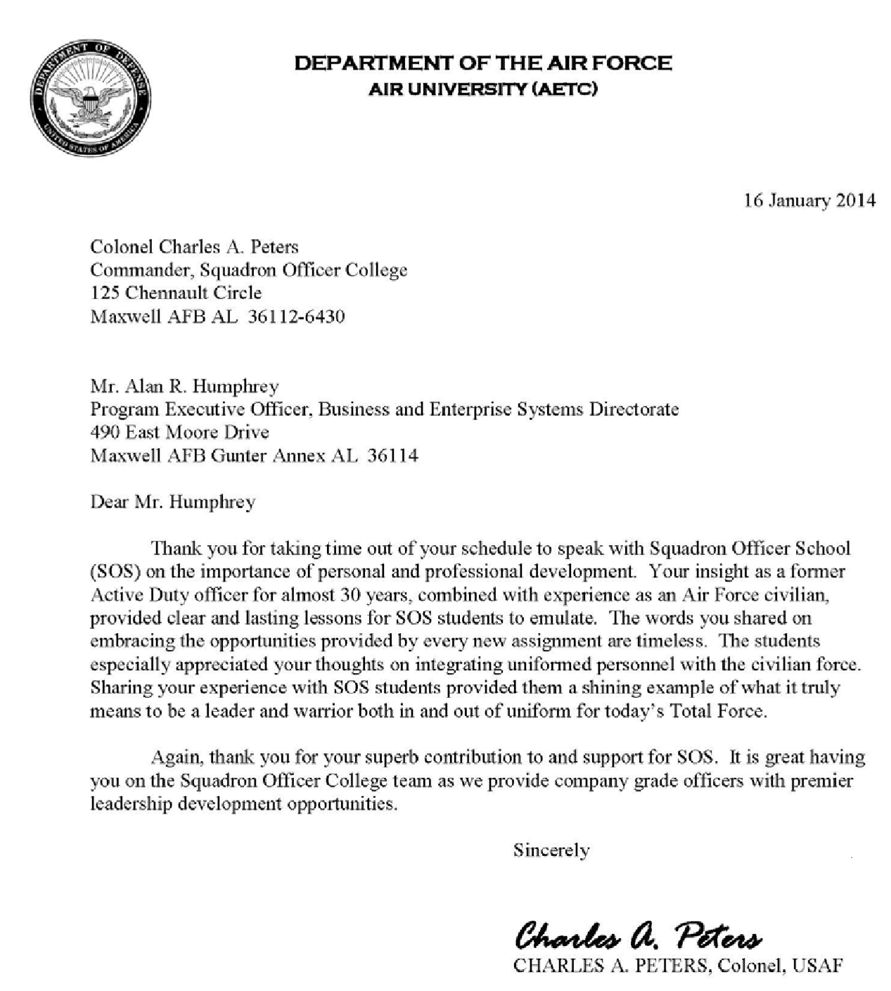
Personal letter
Use correct address, greeting, and close
Can be double space
No contact line

Slide 15
AF Papers
Meant to serve to a wide variety of function
Each type serves a special function
Bullet Background
Background/Position Paper
Notes:
Everything from a simple main point reminder during a speech to analyze of a problem and solution

Slide 16
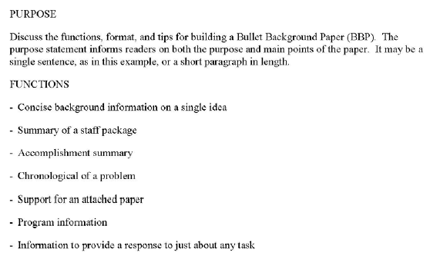
Bullet Background
Background information on signal or multiple issues
Presents information proactively
Summarizes a staff package
Use full sentences
Notes:
- Read ahead for a briefing

Slide 17
Background/Position Paper
Overall format is the same for the two papers
Content is different
Background = Information only
Position = Advocating/Persuade

Slide 18
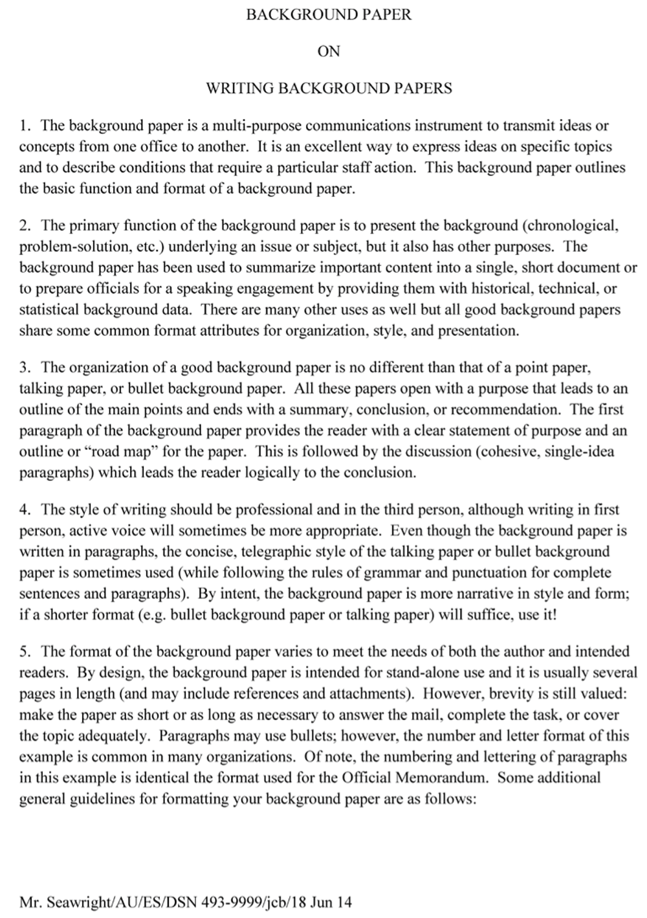
Background/Position Paper
Title ALL CAPS
Intro/conclusion is short and to the point
ID line only on the first page

Slide 19
SSS
Used to aid in the coordinating of any documentation
Placed at the front of the package
Most commonly forgotten item
Some forms already have this built in
Two main formats

Slide 20
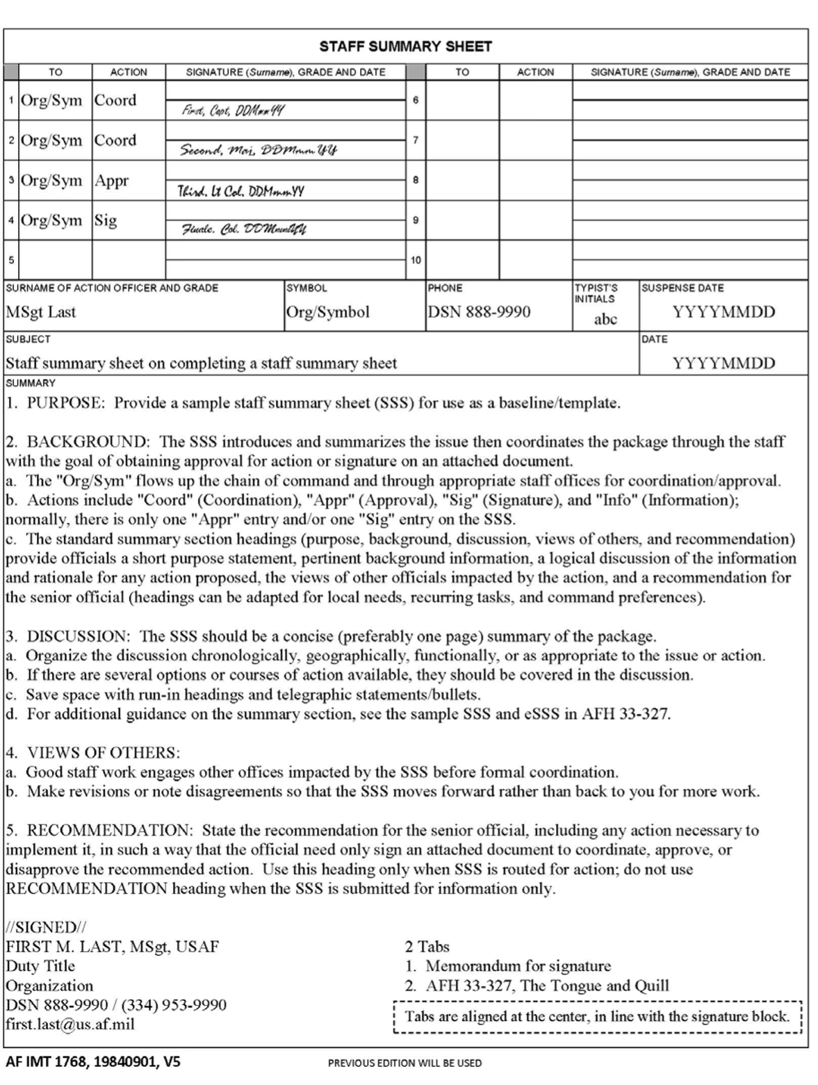
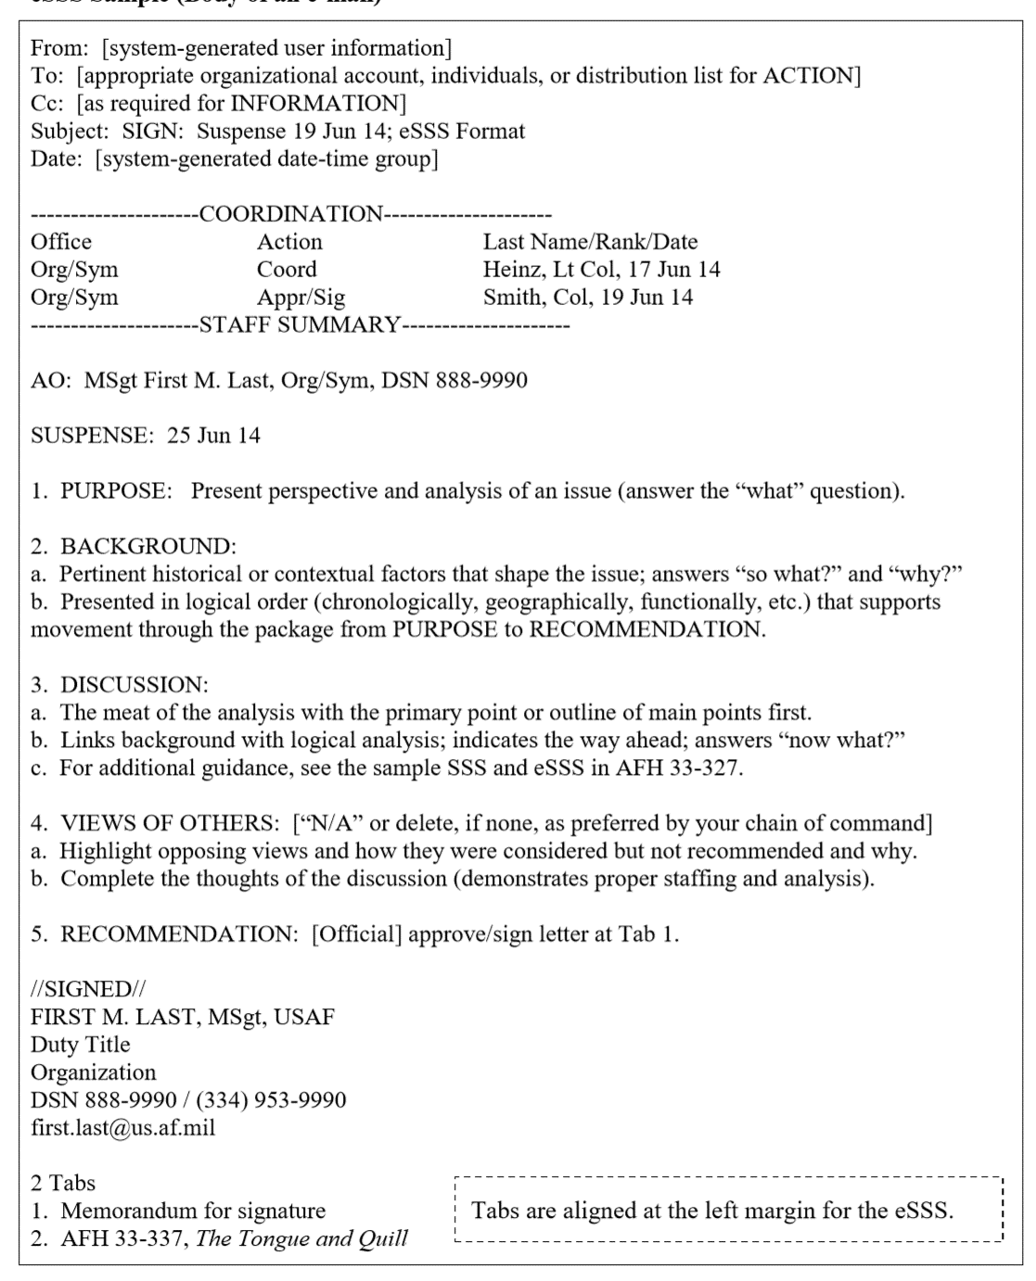
AF Form 1768 eSSS

Slide 21
SSS
Fill in the offices and action
Coord, Appr, Sig, Info, or File
If more than 10 coordinating use a second form
Might have a different action officer

Slide 22
SSS
Provides a introduction and summary to the package
If not listed in tabs do not add to package

Slide 23
E-Mail
Eight rules of “netiquette”
Be clear and cornices
Watch your tone
Be selective about what you send
Be selective about who gets the message
Check your attachments
Keep you email under control
Use proper formatting
Use organizational accounts
Notes:
Get to the point, long email don’t get read
- Watch what you say, can’t pass along sarcasm
- Make sure what you send in the message has a purpose
Who gets it, you don’t know who going to get your email
Make sure its there and the right item
Don’t let your account doesn’t get over loaded
Good formatting can make it easier to read for you and write
Use workflow if not going directly to an individual’s

Slide 24
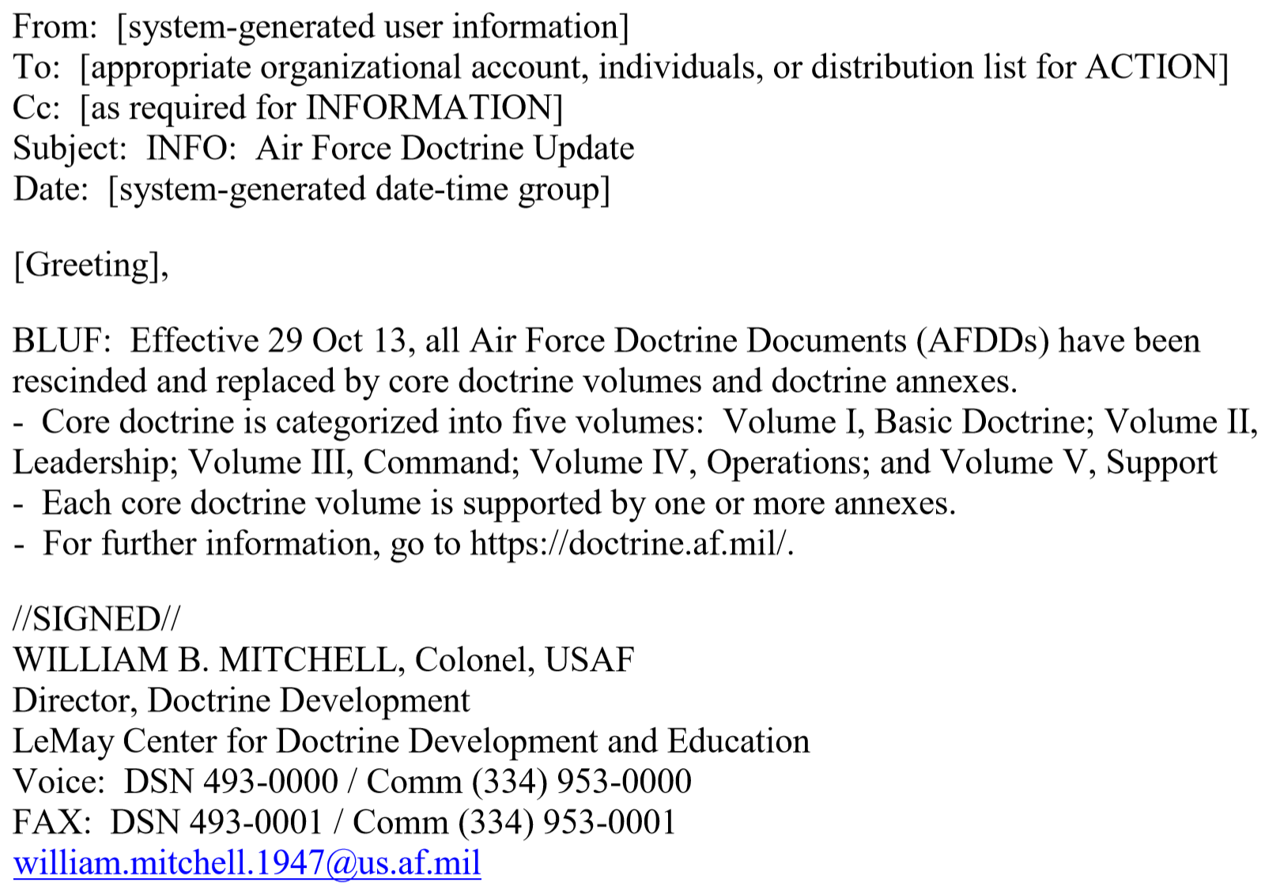
E-Mail
Subject
ACTION
INFO
URGENT
BLIND and BLUF
Notes:
• BL = Bottom Line
• I = Impact on the organization
• N = Next steps to be taken
• D = Details to support the bottom line and any significant discussion points

Slide 25
Summary
Background
Writing/Drafting
Editing /Reviewing
Types/Examples

